Slide 1
Clean Code
Code: https://github.com/adefabian/coding-workshop

Slide 2
AGENDA
01
What is Clean Code
02
Principals of Clean Code
03
Documentation & Testing
04
Where to start

Slide 3
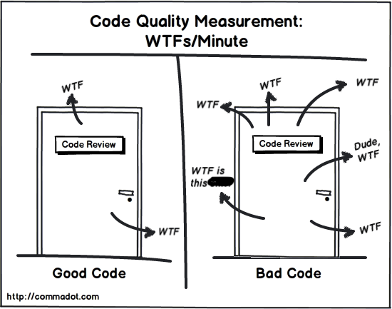
What is Clean Code?
Clean code is code that is easy to understand, easy to modify, and easy to maintain.
The term was was coined Uncle Bob (Robert C. Martin) in his book by the name “Clean Code”
Here are some key features of clean code:
Testable and tested
Elegant
Efficient
Expressive
Expected
Consistency
Readable
Minimal Dependencies
Maintainable (= Testable + Extensible + Understandable)
Self Documenting (we will come back to this later)
Simple
Small functions
Refactored

Slide 4
But why???
Enables you to easily respond to change request
Amplifies comparability and onboarding of team members
Enhances fault detection and fault resolution
Facilitates testing

Slide 5
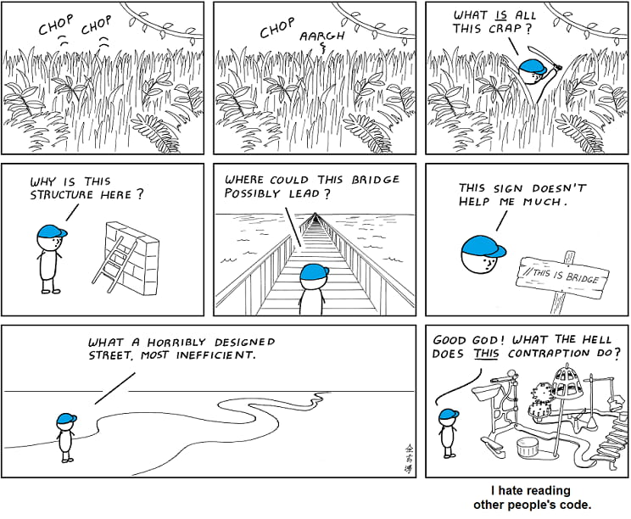
What is Bad Code?
Obscurity; one needs a lot of time to understand what is happening in the code
Needlessly complex
Unclear Naming
Long Functions
Functions that do multiple things
Code Duplication
No Comments or Documentation
Too Many Comments
Inconsistent Style
Tight Coupling
Lack of Modularity
Poor Error Handling
Fragility; one change breaks the whole system

Slide 6
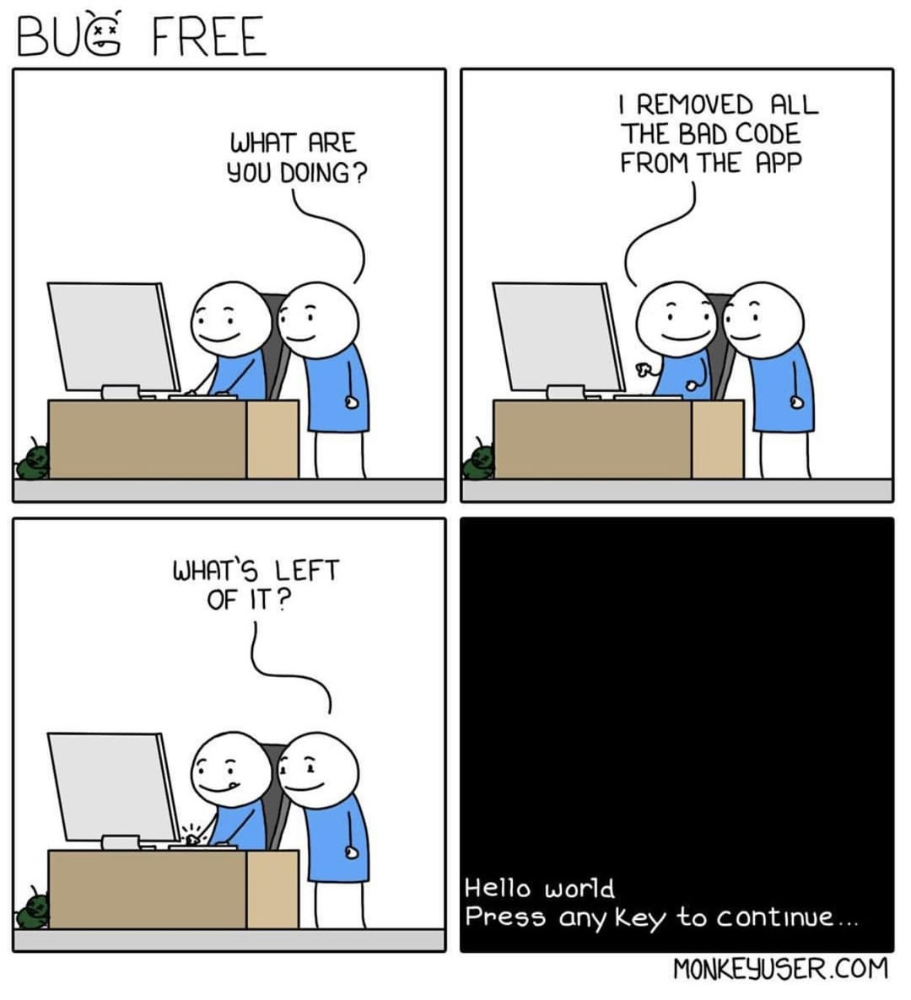
Even more bad Bad Code examples
Out commented code that has not been deleted for a long time
No or turned off unit test
Methods with too many arguments
Endless or seemingly endless nesting
Rigidity; it is hard to make one change without changes many other things

Slide 7
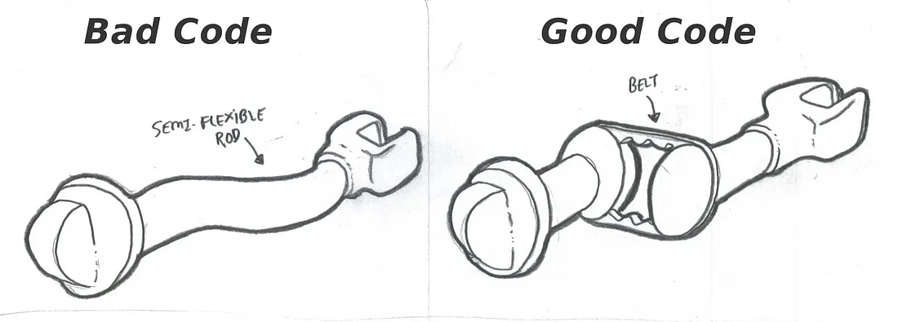
What is Good Code?
Loosely Coupled
Clear dependencies
Consistency (names)
Readable
KISS
Abstractions rather than concretions
Logical separation of concerns
Each Method does only one thing
Modular
Use dedicated value objects instead of many arguments
Descriptive names for classes and variables
Don’t repeat yourself (DRY)

Slide 8
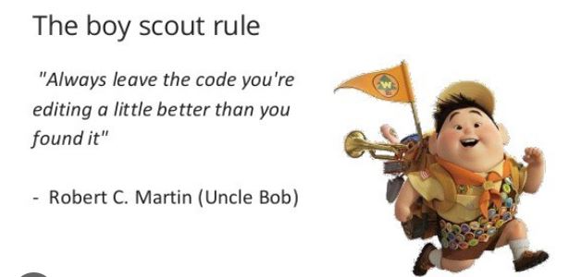

Clean Code Principals
Boy Scout Rule
Keep code cleaner than you found it
If you are working on a method that has technical dept clean it up
While you are at it, clean up the surrounding levels
Make sure new code is always clean
Separate and Clarify Multi-Threaded Code
Create an own file for multi-threaded code
Call clarify it by the class and method names like FileLoaderAsync loadFilesAsync()
Exception Handling
Don’t drop exceptions
Catch exceptions as specific as possible
If you can’t catch a specific exception, catch the broad exception in the upper stack chain

Slide 9
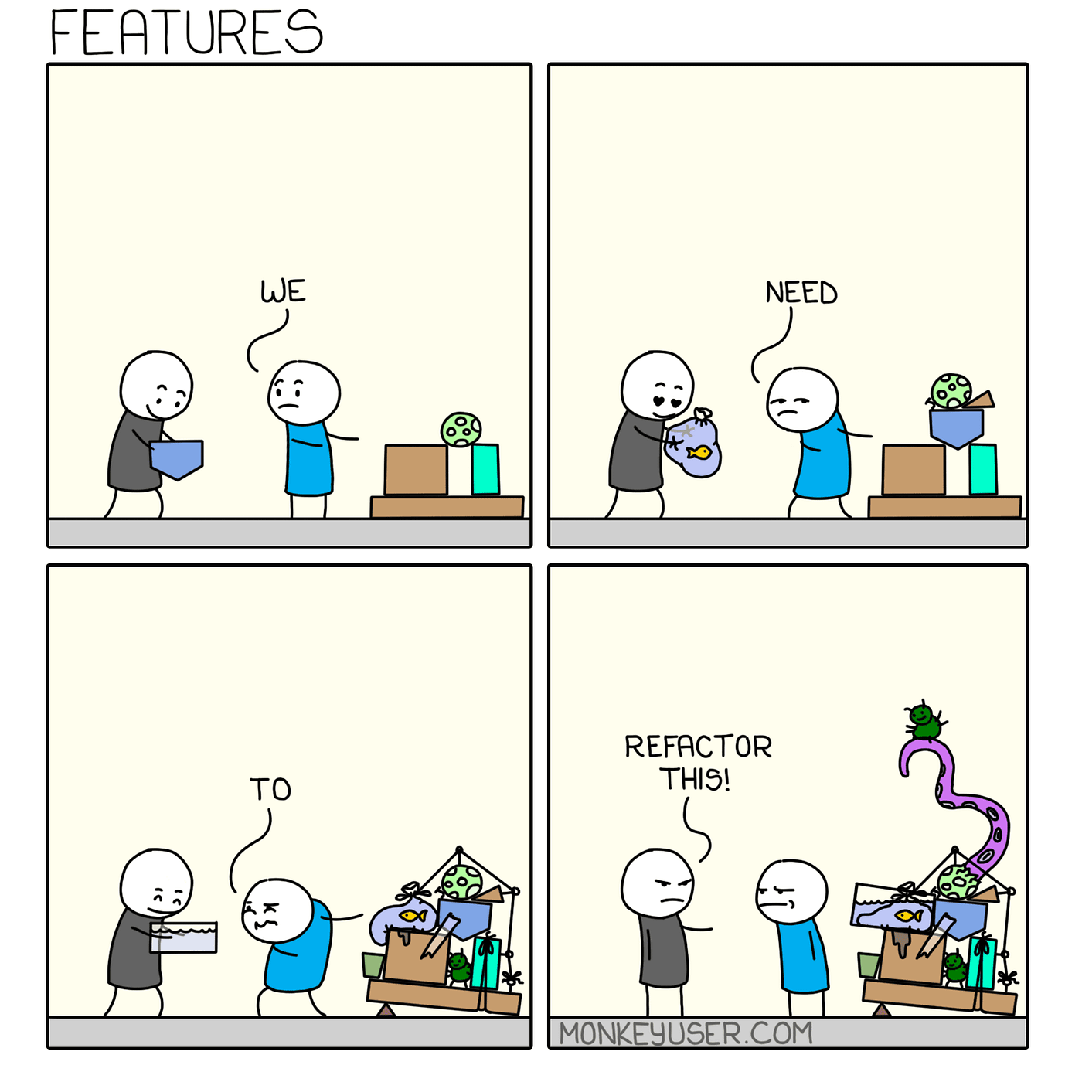
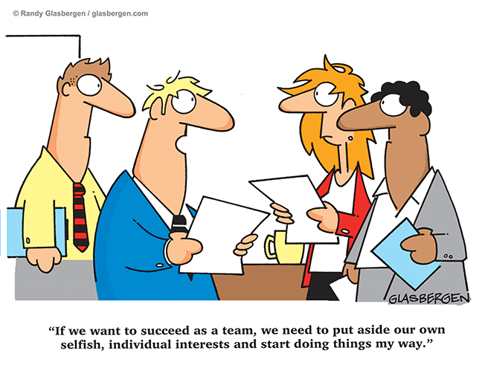
Clean Code Principals
Processes that Support Clean Code
Living Documentation (review it and make sure it is up to date)
Team Structure and Group Responsibility
Everybody holds everyone accountable
Understand business requirements
Technical Debt Log
Refactor regularly
Coding Standards
Code Reviews

Slide 10
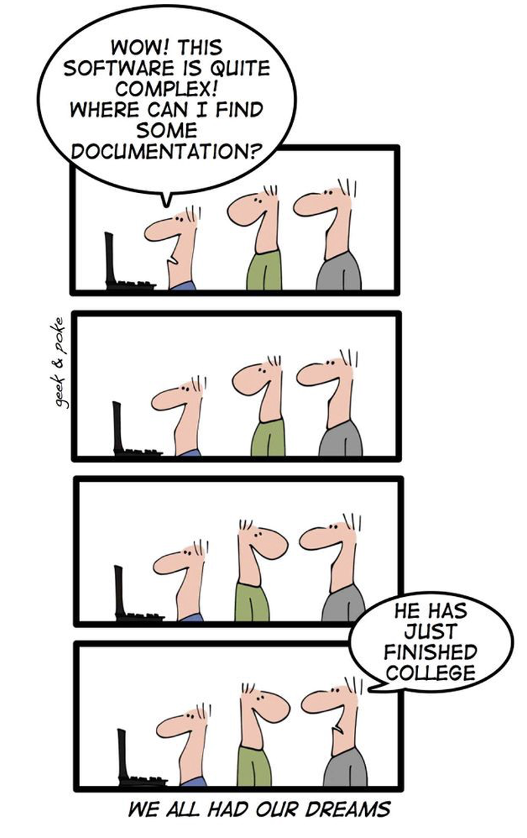
Clean Code Principals
Documentation
Documentation is not for you
Does self-documentation code exist?
Self-documented code is code that is written in such a way that is easily understood without the need of any documentation
Code documentation is very specific what happens here
Documentation helps to better understands what is happening in terms of business AND in the code
Use automated tool for wikis or documentation
Include exception dependencies
Especially important when fixes are added
Self-documentation assumes that the reader has all the domain knowledge and understands the business and the rest of the system
The names and method are all understood and the intention is clear.
Notes:
Documentation helps others and your future self to understand your code

Slide 11

Clean Code Principals
Small Steps
Isolate changes and keep them small and manageable
The system should always be able to run
Test your changes
Ideally you would have unit test that verify the functionality. If not create test before you refactoring.
Verify your changes with appropriate tests
Automate Test
Have different levels of test that run automatically to ensure your refactoring was successful
Refactor bad code to clean code
Notes:
Documentation helps others and your future self to understand your code

Slide 12
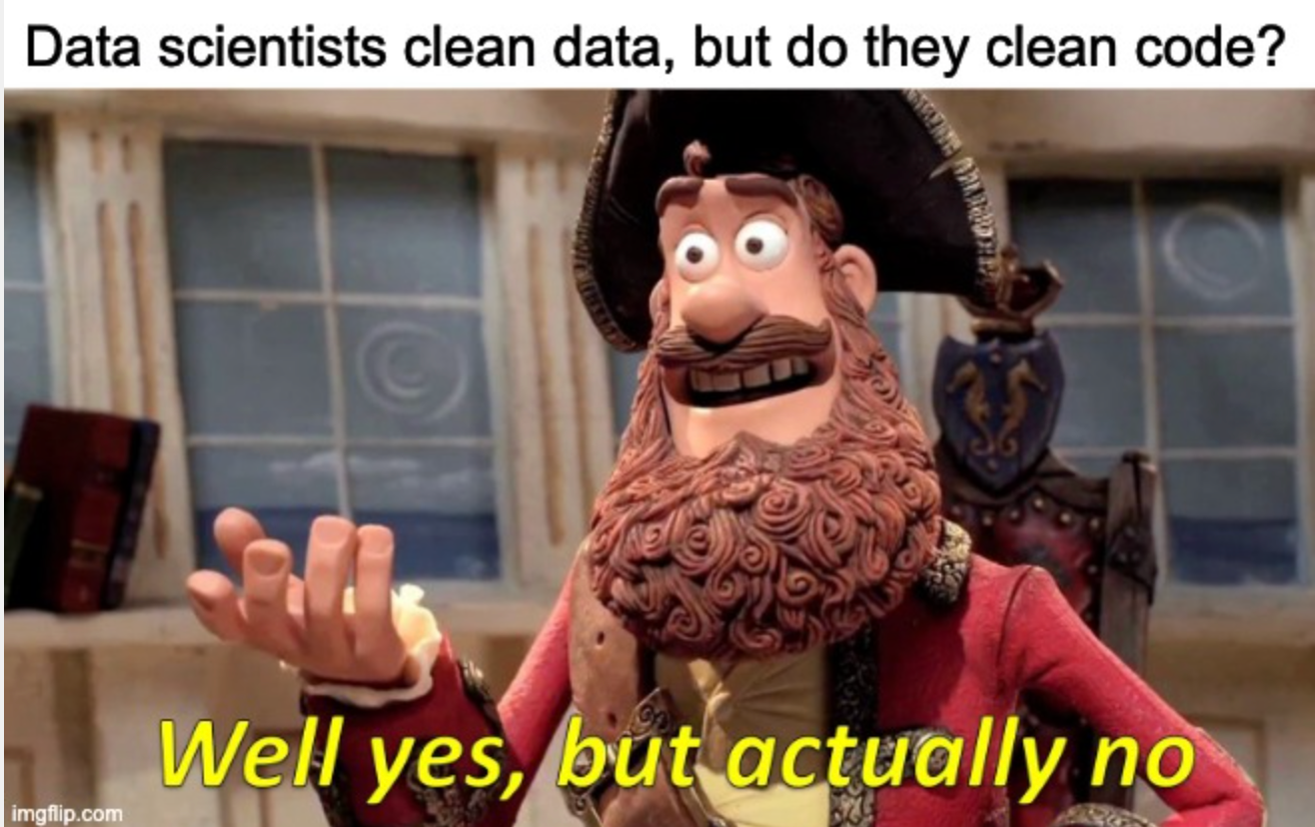
General Tips
No Jupiter Notebooks
Classify everything
Use config files
No magic numbers
Descriptive names
Dedicated value objects
Don’t repeat yourself (DRY)

Slide 13
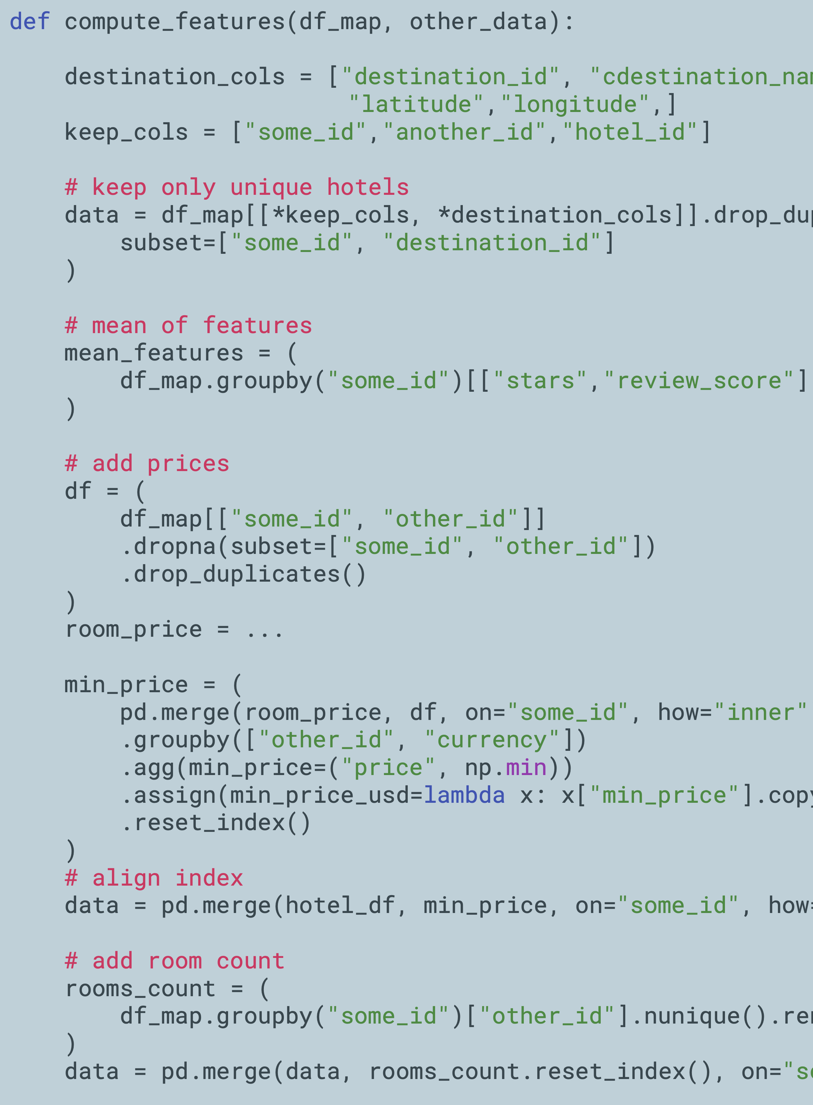
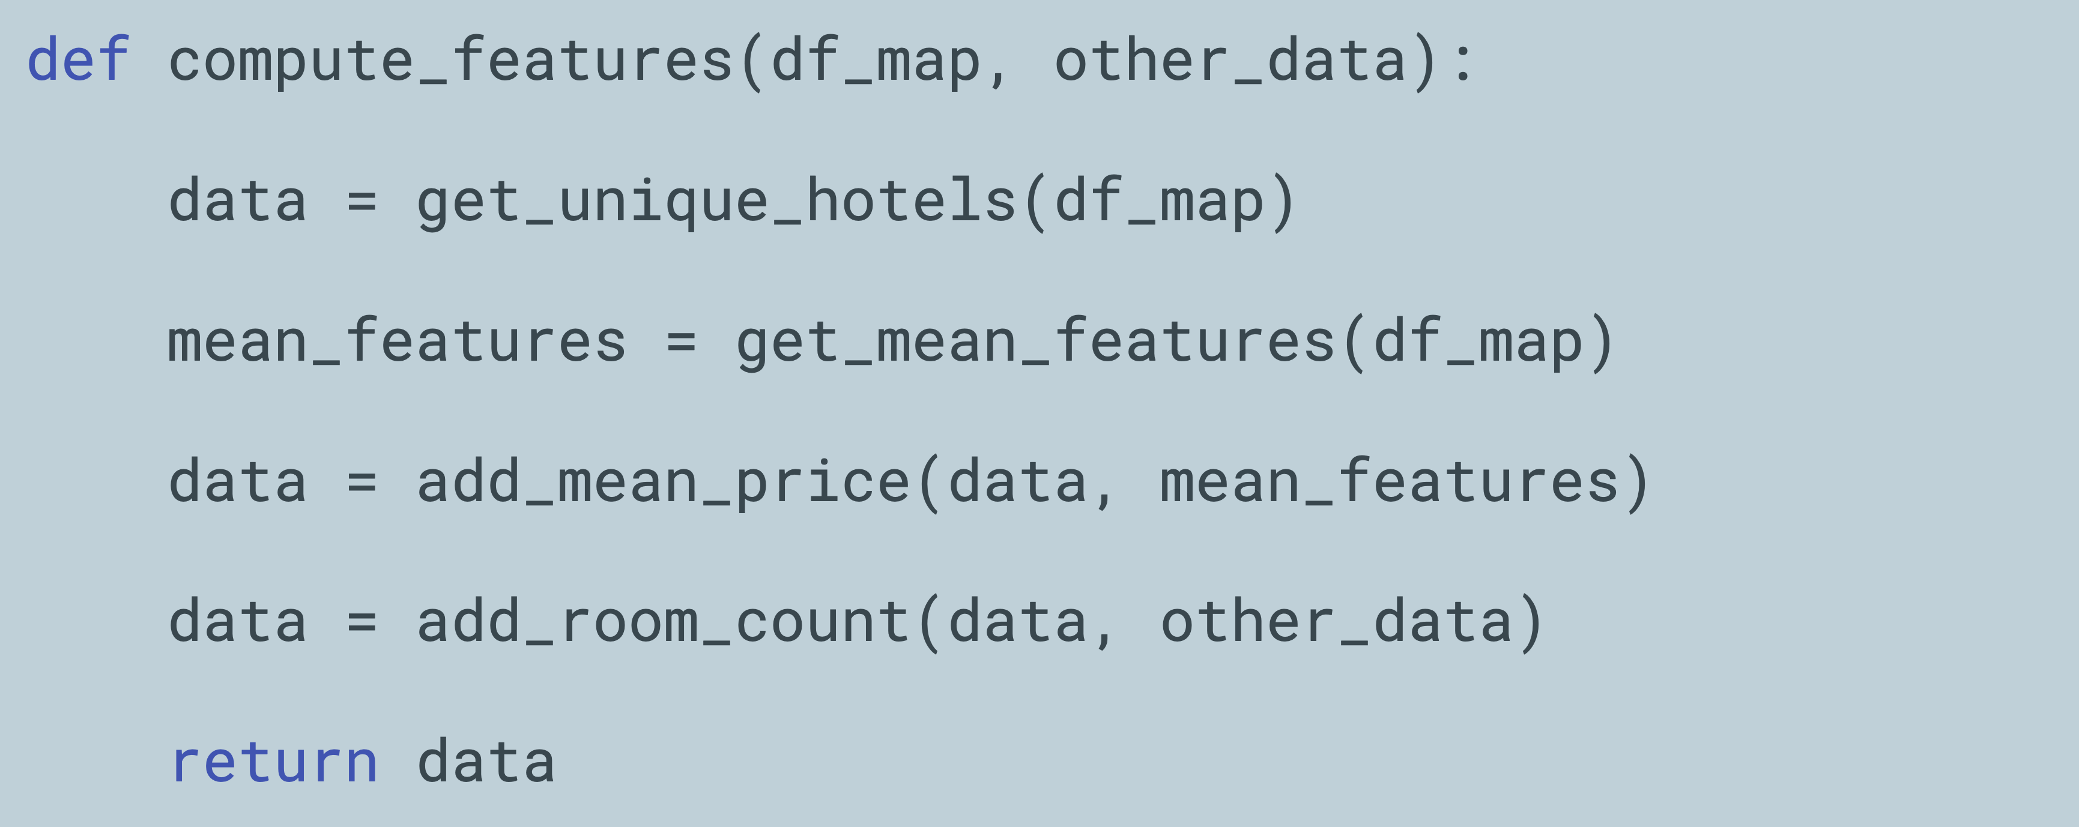
General Tips
Each Method does only one thing

Slide 14
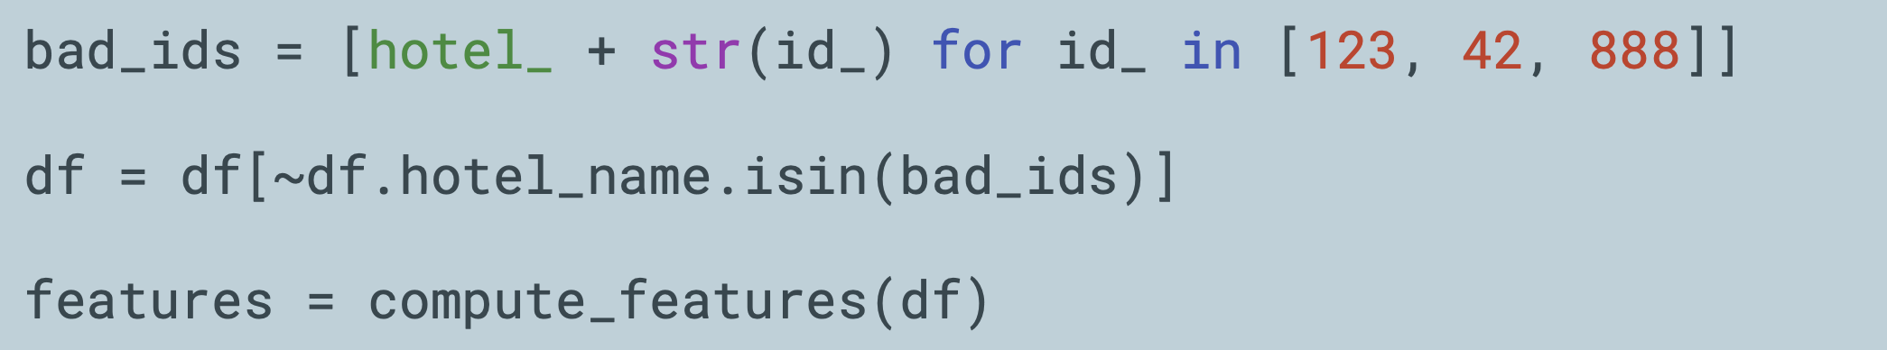
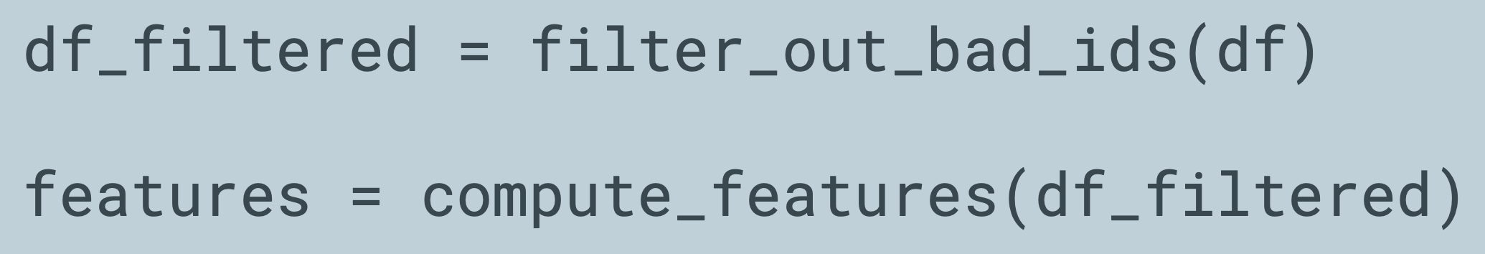
General Tips
Avoid Mixing Abstraction Layers
Don’t put low-level operations on the same level as high-level functions

Slide 15
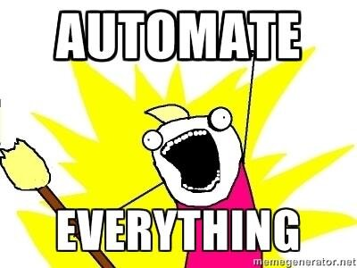
Where to start?
Use Boy Scout Rule
1
Measure code complexity
2
Measure automatically in CI/CD.
Conduct code review.
3
Create a technical debt log.
4
Regularly work through the list and refactor the code.
Insist on clean code even when it takes longer
Clean up ethe code you are working on.
Identify places that need refactoring

